Slide 1





CS 513 - B Knowledge Discovery and Data Mining Project Group 3
HR Analytics
Predicting a change of jobs for Data Scientists
Sangram Vasantrao Thorat
CWID - 20007345
Rishikesh Sanjeev Yadav
CWID - 20007668
Parul Mahajan
CWID - 20010763
Akshatha Vasant Hegde
CWID - 20009287
Team Members

Slide 2
The Problem Statement
Many Big Data and Data science companies often have a problems regarding turnover rates after investing in an employee.
We have conducted an analysis in order to assess the chances whether the employee would look for a new job or will continue to work for the company.
Dataset link :
https://www.kaggle.com/datasets/arashnic/hr-analytics-job-change-of-data-scientists

Slide 3
Data Description
- The Dataset contains 19K rows and the following features - enrollee_id, city, city_ development _index, gender, relevent_experience, enrolled_university, education_level, major_discipline, experience, company_size, company_type, lastnewjob, training_hour and target
- Most of these features are categorical
- The dataset is imbalanced
- There is missing imputation

Slide 4
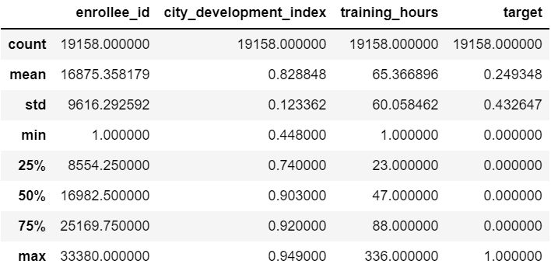
Data description cont.

Slide 5
Feature Description
The DataSet contains the following features -
enrollee_id : Unique ID for candidate
city : City code
city_ development _index : Development index of the city (scaled)
gender : Gender of candidate
relevent_experience: Relevant experience of candidate
enrolled_university: Type of University course enrolled if any
education_level: Education level of candidate
major_discipline :Education major discipline of candidate
experience: Candidate total experience in years
company_size: No of employees in current employer's company
company_type : Type of current employer
lastnewjob: Difference in years between previous job and current job
training_hours: training hours completed
target: 0 – Not looking for job change, 1 – Looking for a job change

Slide 6
Preprocessing
All features are included in the analysis. Categorical values are encoded to integers for easier data processing.
We replace the null values of the dataset with the mean of the columns of the null values. (other methods of replacing null values have been considered)

Slide 7
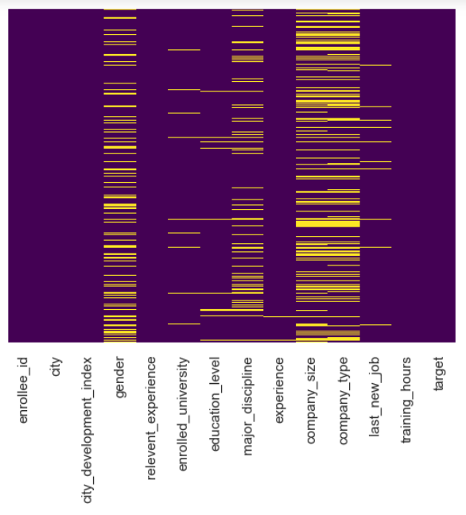
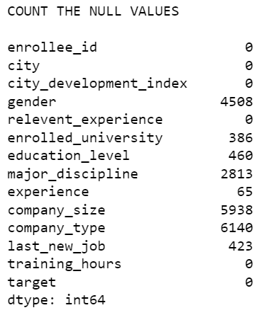
(Preprocessing) Null values are counted and shown in a heatmap and then processed

Slide 8
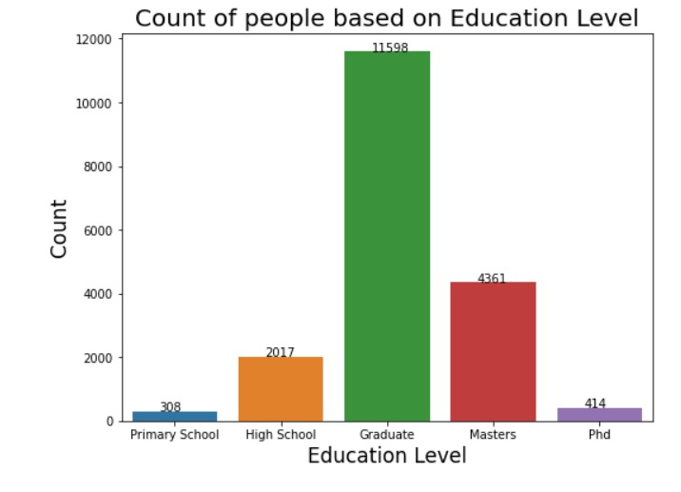
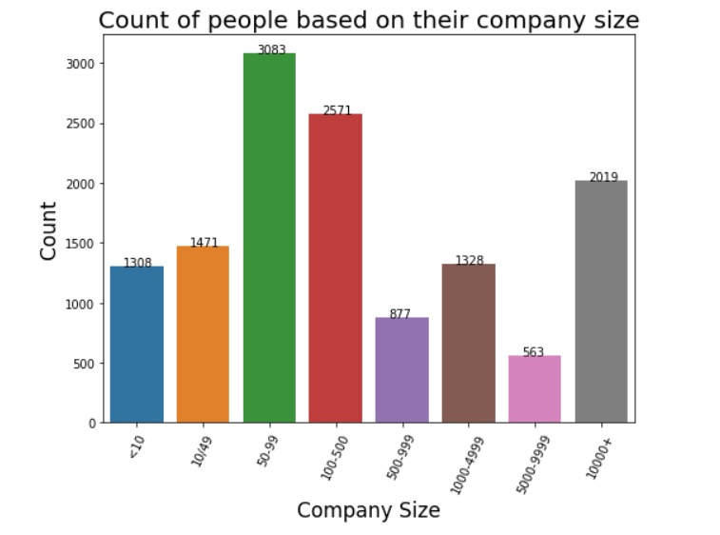
Categorical feature distributions

Slide 9
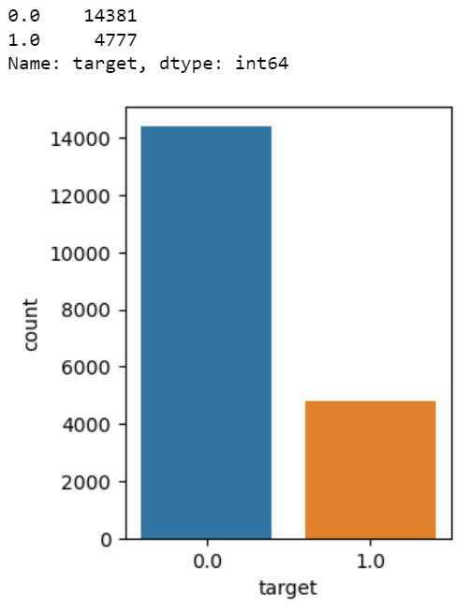
As we have described, we have an imbalanced dataset. We have considered using SMOTE (Synthetic Minority Over-sampling Technique) and have noticed that when using SMOTE accuracy reduces however the precision, recall and f1 score is more balanced. We have applied the SMOTE method to two algorithms.

Slide 10
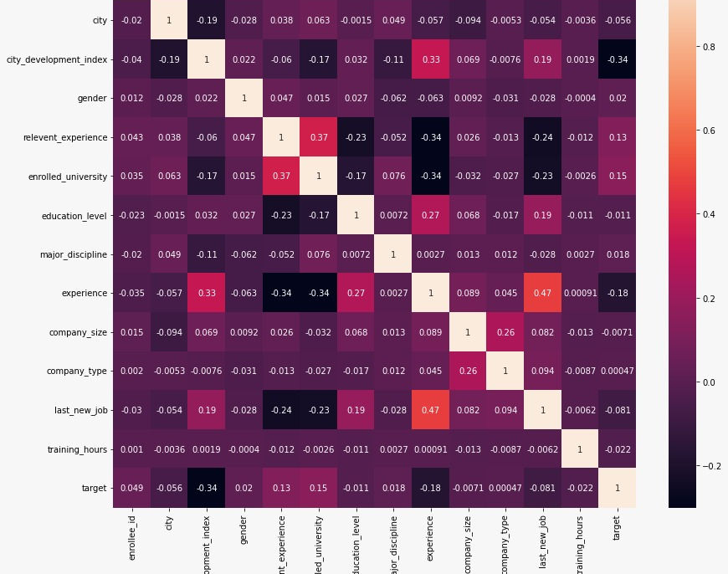
Plotting Feature Correlation

Slide 11

Classification Algorithms
Logistic Regression
K Nearest Neighbors
Random Search with Randomized Forest
Support Vector Machines with GridSearch
Multilayer Perceptron
AdaBoost Classifier
Bagging along with Random Forest
K Means

Slide 12
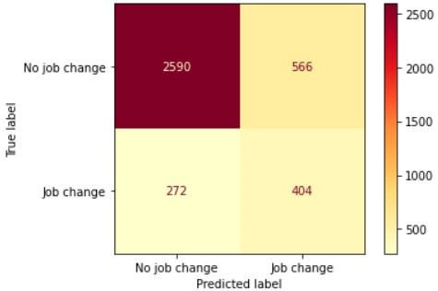
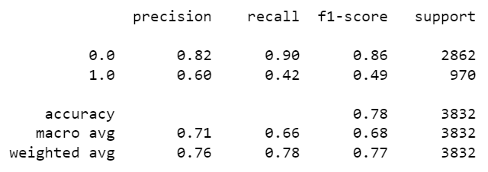
Support Vector Machines with GridSearch

Slide 13
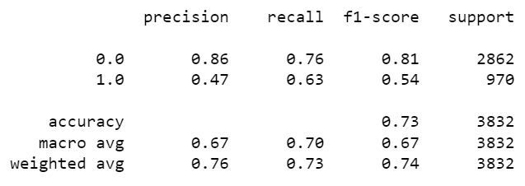
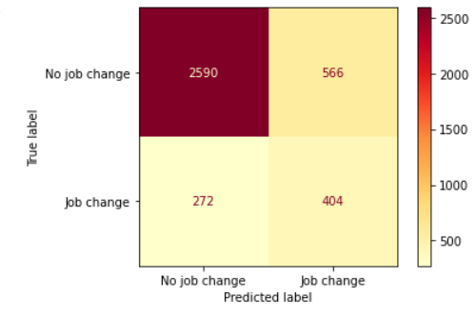
SVM GridSearch using SMOTE

Slide 14
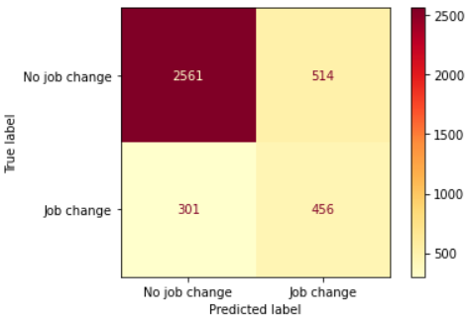
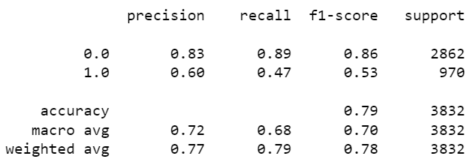
Multilayer Perceptron

Slide 15
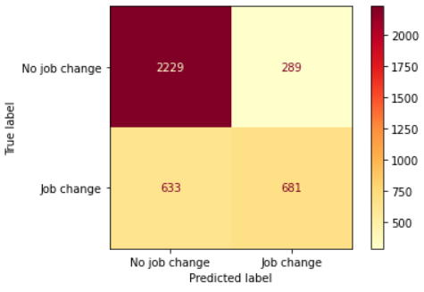
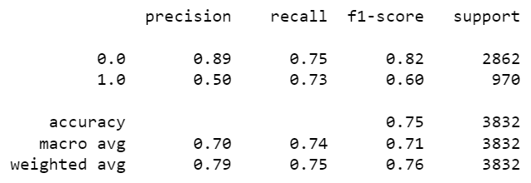
Multilayer Perceptron using SMOTE

Slide 16
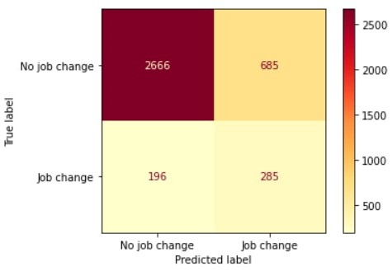
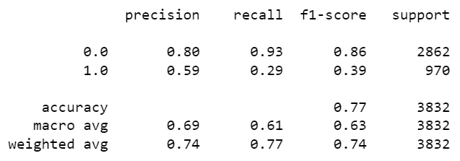
Logistic Regression

Slide 17
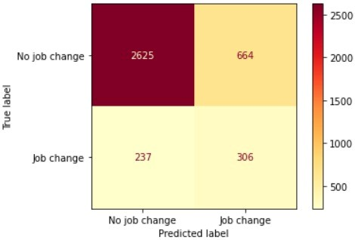

K-nearest neighbors

Slide 18
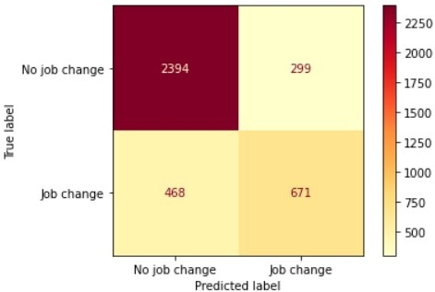
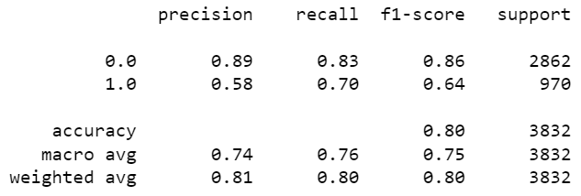
Random Forest

Slide 19
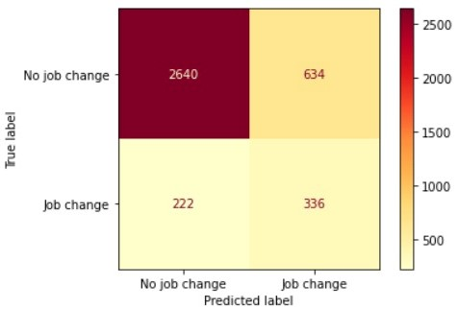
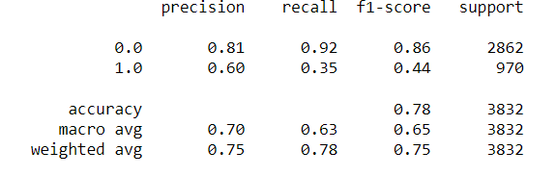
AdaBoost Classifier

Slide 20
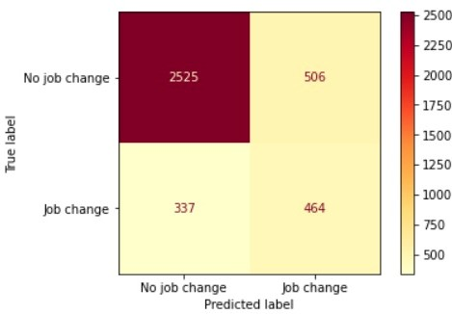
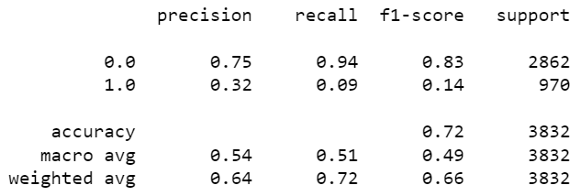
Bagging along with Random Forest

Slide 21
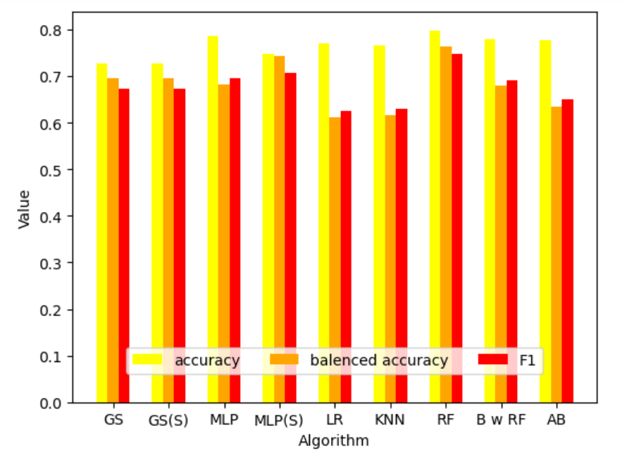
Accuracy Comparison

Slide 22
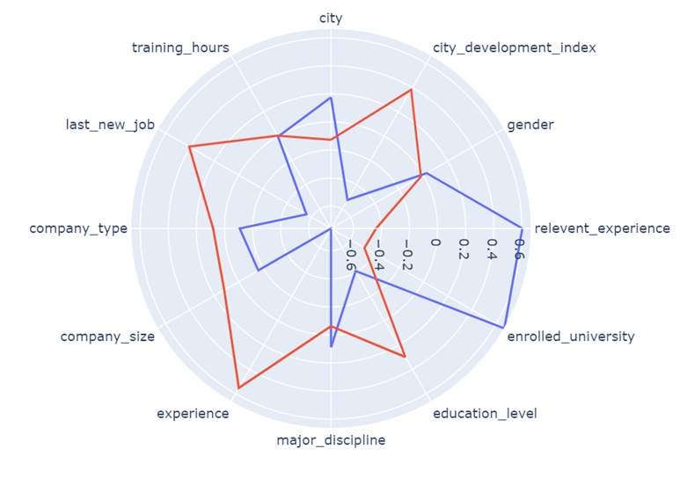
K – Means Algorithm

Slide 23
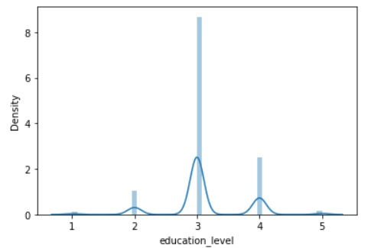
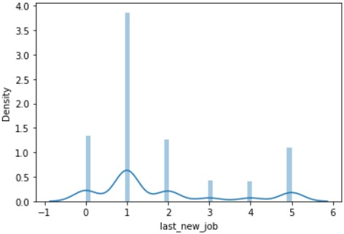
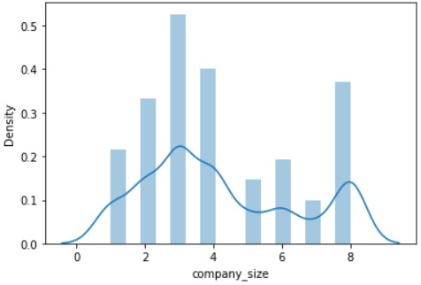
Some interesting inferences that we made along the way
Distribution plot of features for change of job (i.e., target value = 1)

Slide 24
In Conclusion
We can see that the Random Forest method works the best out of 9 algorithms.

